Slide 1

UD 3
PROBABILITY
1

Slide 2
The object of STATISTICS is the study of random phenomena like:
- To throw a dice (results: 1, 2, 3, 4, 5, 6)
- To measure the weight of something (results: continuous scale)
- To choose a piece produced in a factory (results: correct / defective)
SAMPLE SPACE (E): Set of results that can be obtained when conducting a random experiment.
Examples:
- obtain a head when throwing a coin. E finite
- number of times that we should throw the dice until obtaining a six. E infinite (discrete)
- length of a piece in cm. E infinite (continuous)
2

Slide 3

DICE throwing: unpredictability of results, BUT statistical regularity
The statistical regularity observed in a random experiment is the pattern that allows to MODEL the results.
PROBABILITY:
Measure of the certainty (objective or subjective) of any proposal or of an event associated to a random experiment. Varies from 0 (null certainty, impossible event) to 1 (certain event).
PROBABILITY CALCULATIONS
Mathematical model used to build statistical inference
- Approaches of probability:
3

Slide 4
WHAT IS THE PROBABILITY OF...
- obtaining 6 when throwing a dice?
- obtaining a defective piece if one is chosen at random?
- having rain tomorrow? www.rtve.es/eltiempo
- existence of extraterrestrial life?
- a big meteorite to crash with Earth?
www.20minutos.es/noticia/203639/0/nasa/asteroide/tierra/
CLASSICAL APPROACH (FREQUENTIALIST):
- It is the result of a random experiment that can be repeated (drawback: restricted to repetitive experiences)
- probability = relative frequency of occurrence of an event.
- Laplace: probability = favorable cases / possible cases
BAYESIAN APPROACH (SUBJETIVIST):
- Not the result of a random experiment
- probability = degree of “truth” or centainty that a given individual has about a proposal
4

Slide 5
EXERCISE: Bayes’ theorem
Event B: Accident in a road
Type of vehicle:
event A₁=car, A₂=motorcycle, A₃=truck
A priori probabilities P(A_{i})
P(A₁)=P(car)=0.50 (50% of vehicles are cars)
P(A₂)=P(motorcycle)=0.20
P(A₃)=P(truck)=0.30
Probability of having an accident according to the type of vehicle:
P(B/A₁)=P(accident/car)=0.15
P(B/A₂)=P(accident/motorcycle)=0.30
P(B/A₃)=P(accident/truck)=0.10
If there is an accident, what is the probability of being an accident caused by motorcycle?
5

Slide 6
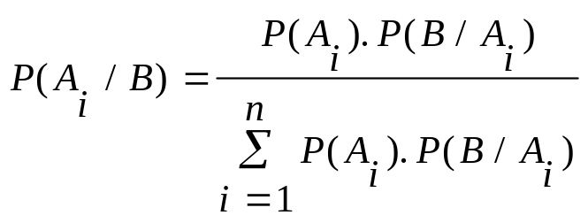
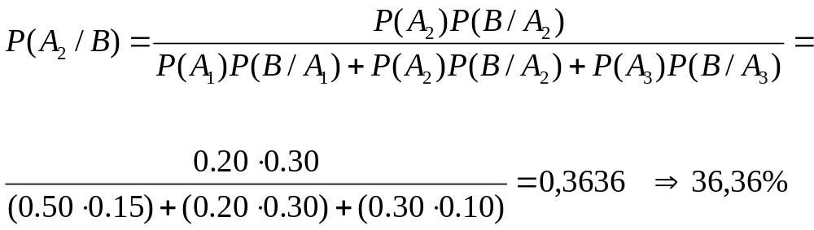
If there is an accident, what is the probability of being an accident caused by motorcycle?
P(car/accident)=0.454
P(truck/accident)=0.182
6

Slide 7
EXERCISES
(after finishing “teacher notes” file)
7

Slide 8
EXERCISE:
A random experiment consists of throwing a dice. Considering the events:
A = obtain an even number (2, 4, 6)
B = obtain a number higher than 4.
C = obtain 6.
Are A and B independent?
Are A and C independent?
Are A and B exclusive?
Are A and C exclusive?
8

Slide 9
Are independent “women” and “weight≤55”?
weight
gender
40 55
55 70
70 85
85 99
Row
Total
MEN
0
.0
42
73.7
41
97.6
5
100.0
88
67.7
WOMEN
26
100.0
26
100.0
15
26.3
1
2.4
0
.0
42
32.3
42
32.3
COLUMN
TOTAL
26
20.0
57
43.8
42
32.3
5
3.8
130
100.0
¿P (woman with weight ≤ 55)?
P(woman/weight≤55)=1
P(woman)=0.323
P(weight≤55)=0.2
9

Slide 10
Example
In one pack with 10 pieces, 4 of them are defective. If 3 pieces are taken out by random, what is the probability of being correct the three pieces?
Calling C_{i}=piece i correct, the event requested is
(C₁∩C₂∩C₃) and the probability is:
Solution:
P(C₁∩C₂∩C₃)=P(C₁) · P(C₂/C₁) · P(C₃/C₂∩C₁) =
6/10 · 5/9 · 4/8 = 120/720 =1/6
10

Slide 11
A given population is formed by N=50 pieces in a box, being 10% defective. One piece is extracted, and the event A “the piece is defective” is proposed. A second piece is extracted next (without replacement of the first one), and the event B “the second piece is defective” is proposed.
Calculate P(B) and P(B/A).
Are A and B independent?
If N= 100.000, can A and B considered as independent events, despite not replacing the first piece?
11

